Slide 1
Should we reject the natural rate hypothesis?
May 2018
Edgeworth lecture, Dublin
Olivier Blanchard

Slide 2
50 years ago: The natural rate hypothesis
    Friedman’s presidential address. 1967
    In effect, application of general long-run neutrality of money proposition
    Two sub-hypotheses:
      The natural unemployment rate independent of monetary policy.
      ``Independence hypothesis’’
      Maintaining actual rate below natural rate leads to increasing inflation.
      ``Accelerationist hypothesis’’
    Strong organizing framework, and strong policy implications:
      Structural versus stabilization policies.
      Limits to stabilization policies: Booms fully offset by busts
      Monetary policy can smooth, but no more.
2

Slide 3
Acceptance, old and new grumblings
    Quickly accepted.
      Empirically: Increase in Phillips curve coefficient, from 0 to 1.
      Conceptually: Dominant framework
    Basis for inflation targeting framework. ``Divine coincidence’’
    But:
      The disinflations of the 1980s, and hysteresis.
      More recently:
      The effects of the Great Financial Crisis on output.
      The disappearance of the accelerationist Phillips curve.
3

Slide 5
Relation between wage inflation and unemployment, 2008-1 to 2015-2
Arias, Erceg, Trabandt

Slide 6
Map
    The independence hypothesis.
      Persistence versus permanence
      Macro evidence
      Micro evidence
    The accelerationist hypothesis.
    Policy implications
6

Slide 7
1. Persistence versus permanence
    Need to clarify the issues. Discussion often presented as
      Standard models: zero effect of m pol on potential output
      versus :
      Hysteresis: permanent effect of m pol on potential output
    In fact:
      All models have some, persistent, effect of m pol on potential output
        Recessions, capital accumulation, potential output
        State variables. Capital, Unemployment (if matching frictions).
      Hysteresis models often do not imply permanent effects
        R&D, TFP, and potential output
        Disenfranchised workers.
    Bottom line: Issue is the degree of persistence. High or low?
7

Slide 9
Macro evidence. Unemployment.
    Effects of monetary policy shocks?
      Look at recessions caused by intentional disinflations
      Clearly monetary shocks. Large. Plausibly exogenous
    Data set. 22 advanced economies, 50 years.
      Identify recessions. 122
      Caused by disinflation decision. 22.
    Methodology
      Look at average unemployment rate pre- and post-recession
      Time intervals. Pre-recession. -2 to -6, …, -2 to -12
              Post-recession. +3 to +7, …, +10 to +14
    Caveats:
      Time fixed effects, heterogeneity, actual or natural rate?
9

Slide 11
Macro evidence: Output
    Similar approach for output.
      Why not look at output?
    Compute a pre-recession log-linear time trend.
    Extrapolate.
    Look at post-recession output gap.
    Do it over various pre- and post-recession intervals
    Complication. Underlying decreasing time trend.
      If not corrected, will find negative output gaps on average
    Evidence.
      Less impressive than for unemployment
      Decomposition: employment, productivity
11

Slide 13
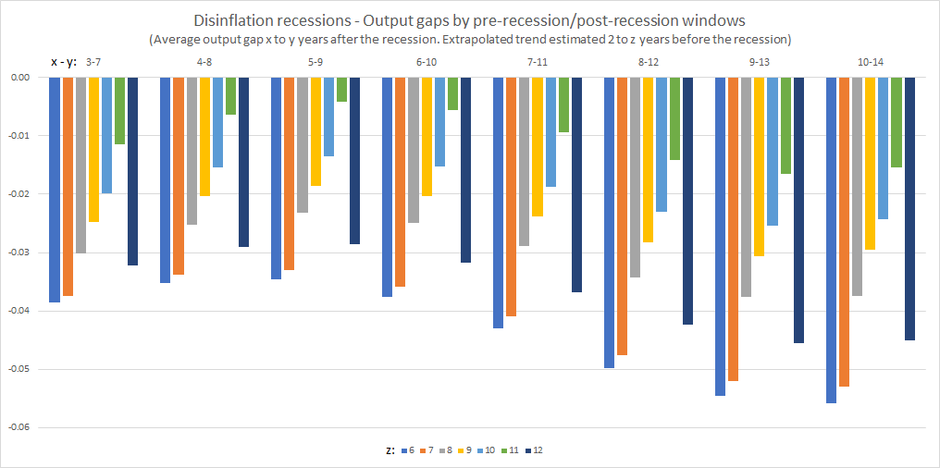

Slide 14
Can we learn from other recessions?
    Can we learn from the other recessions, say, caused by oil shocks, financial crises, etc?
    Yes, with one additional strong assumption:
      Zero long run elasticity of labor supply/wage curve
      If so, can look at unemployment. (not output. Why?)
    Evidence.
      Strong effects for both oil shocks, and financial crises.
      Similar caveats. Largely bunched in time, so potential time effects.
14

Slide 16
Micro evidence. Persistence channels. 1.
      The initial hysteresis argument (Blanchard-Summers). Insiders
        Unions set wages. (eventually) do not care about the unemployed members.
        No pressure of (some) unemployment on wages.
        Natural rate has a unit root
      Too strong. Unemployment matters
        Unemployment threat if fired
        Unemployment threat from hiring unemployed
        Role of employment protection: Firing/hiring costs
      DMP framework. Now incorporated in some DSGE
      How much persistence?
        A function of labor market institutions.
        Employment protection, u benefits, structure of bargaining
16

Slide 17
Micro evidence: Persistence channels. 2
    Loss of morale, skills, employability.
    Probability of employment if unemployed (CPS):
      1 month : 28% if U<27 weeks, 14% if U>27 weeks
      15 months : 55% 40%
    No proof of hysteresis however. Best hired first, pool gets worse?
      Looking at past history of the short-term and long-term u
      (Abraham et al). Similar employment status 8 quarters before
    If this is the channel, then asymmetric hysteresis.
      LTU convex in U. *
      More hysteresis in deep recessions than in booms.
17

Slide 19
Micro evidence: Persistence channels. 3
    Focus at this point on low labor force participation (rather than unemployment rate, which is very low) in the US.
    Largely a downward trend, but is there more?
    Evidence (Yagan) 7.2% decrease in 2015 LFP for 30-49 cohort in 2007
      4.8% due to demographics. 1.8% due to high u in 2007-2009
    The longer evidence from disability insurance
      Applications highly cyclical. *
      Once accepted, low probability of coming back.
      Over last 10 years, 20% ``excess unemployment’’
      2.4 m applications more. (1.7% of labor force)
      Acceptance rate: 35%, so 0.8 million. (0.6% of labor force)
19

Slide 22
Micro evidence: Persistence channels. 4
    Turning to persistent effects of recession on productivity.
    No evidence that it plays a role in disinflation-caused recessions
  R&D cyclical. But effect of cycle is small. 1% less growth. 1% less R&D.
    Speed of adoption. Evidence. Some cyclical elasticity. Gertler et al.
    Recessions and reallocation. Schumpeterian cleansing or inefficient closures? Foster et al: small positive effect (except during the GFC)
22

Slide 23
The accelerationist hypothesis
      The simple Phillips curve.
        Π = a Π(-1) + b (U-U*)
      Phillips, Solow/Samuelson. a close to 0.
      Friedman: If try to use the trade off, a will go to 1.
      (Lucas/Sargent. Rational expectations version. NK version. )
      The evidence. Estimation with 15-year rolling sample
        Dramatic increase after Friedman’s address
        Dramatic decrease since early 2000s.
23

Slide 24
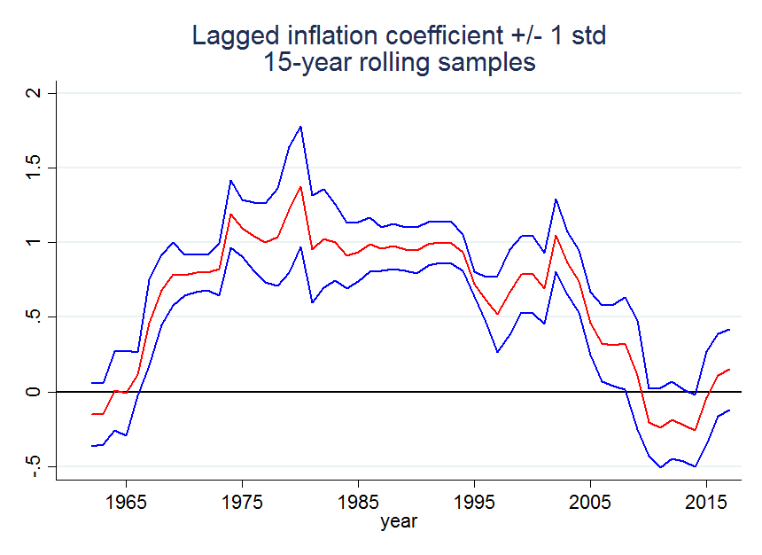

Slide 25
Credibility or lack of salience?
      Why has the coefficient decreased back to zero?
        Credibility? Inflation target, and inflation targeting.
        Lack of salience? At low, stable inflation, inflation ignored
      How to test? Not easy
        If credibility, response to core, but not to (headline – core)
        If salience, response to (headline – core), but not to core.
          (e.g. response if price of gas increases/decreases a lot)
      Evidence from behavior of professional forecasters (SPF) households (Michigan survey).
25

Slide 26
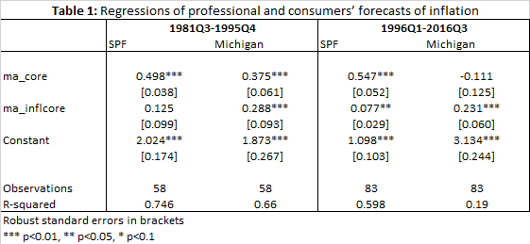

Slide 27
Policy implications. 1
      Long way from knowing enough. Strength, persistence, asymmetries…
      Nevertheless, a simple formalization:
    (1) y*(+1) = a y* + b (y-y*)
    Pure independence hypothesis: b=0.
    Pure hysteresis hypothesis : a=1, b>0
    Realistic models: coefficients in between.
    (2) Π = c(y-y*) + E Π, EΠ = 0 if –x ≤ Π ≤ +x , Π(-1) otherwise
    Salience if x>0
27

Slide 28
Policy implications. Inflation/output trade offs
      Consider a one-period increase in the output gap, y-y* = Δ
      If both independence and accelerationist hypotheses hold:
        Permanent increase in inflation of c Δ
        One-period increase in output of Δ
      If only independence assumption fails (a, b positive)
        Permanent increase in inflation of c Δ
        Increase in output of Δ, b Δ , ab Δ ,…, : Bigger
      If only accelerationist assumption fails (x> Δ >0)
        Increase in inflation for one period of c Δ: Smaller
        One period increase in output of Δ
      If both fail
        Increase in inflation for one period of c Δ: Smaller
        Increase in output of Δ, b Δ , ab Δ ,…, : Bigger
28

Slide 30
Conclusions
      On the independence hypothesis
        M policy (``demand shocks’’) affects potential output/natural rate. a,b positive. But precise values?
        Macro/micro evidence for highly persistent effects mixed.
          Most convincing is disenfranchising.
      On the accelerationist hypothesis (or its RE version)
        Some evidence of lack of salience. Usable?
      On policy implications. Not quite there yet.
      We really do not know the relevant values of a,b, x
      Need to work much more on wage bargaining channel.
      Micro evidence on disenfranchising fairly strong.
      What should the Fed do today?
30

